Slide 1
ROW ACCESS POLICIES
Notes:
Draft: https://docs.google.com/presentation/d/1r3-F_wPwu1jMn6Us1NCczD9z1d9R0bMpfLsocaP3CqA/edit?usp=sharing
Change History
Author Date Details
-------------------------------------------------------------------------------------------------------------------------------------
Kim Te 26-Oct-2021 Created initial deck based on product team demo

Slide 2
HOW IT WORKS
Policy contains SQL expressions to determine which rows should be visible.
Policy assignment to table “binds” input column to policy parameters.
Jordan
(Role: EU_RL)
Table: Sales
Customer | Spend | Region
AGM | $5,757,000 | Europe
Policy
Customer | Spend | Region
ACME | $820,000 | North America
Koko | $2,100,00 | North America
AGM | $5,757,00 | Europe
Kira | $228,000 | Asia
Unauthorized rows are dynamically filtered at query time.
(Policy Admin)
Look up
Alex
(Role: NA_RL)
Customer | Spend | Region
ACME | $820,000 | North America
Koko | $2,100,00 | North America
Filtered results are returned.
Table: Access Mapping
Role | Allowed Region
EU_RL | Europe
NA_RL | North America
2

Slide 3
ROW ACCESS POLICIES OVERVIEW
Object (s)
Row Access Policy
Provides content-based access restrictions
Limit access to individual rows based on context
Complete mediation: Enforced for all users and accesses
Can be applied to tables, views, and external tables
Works with data sharing and semi-structured data
DB 1
Table 1
Row Access Policy
Apply
<policy condition>
DB 1
View 1
Policy Admin
<row filtering decision>
DB n
Table n
Common Policy Framework
Policy: A schema-level object that defines a set of rules
Decoupled policy definition and application
Same policy can be applied to multiple objects
Uniform syntax and semantics across multiple features for ease of use
Dynamic Data Masking policies
Row Access Policies

Slide 4
EXAMPLE: SALES REGIONALIZATION
Setting
Global sales tracked in the SALES table
Regional sales managers responsible for sales in individual regions (AMER, APAC, EMEA)
Policy Goal
Sales managers can access rows only for their own respective regions
Sales executives can see and analyze all sales globally
Table SALES
emea-sales-rl
first_name | last_name | location | spend | sale_date | region
Avo | Laudham | Athens, Greece | 10000 | 2021-01-07 | EMEA
Dana | Avory | Osaka, Japan | 7000 | 2021-06-17 | APAC
Cesar | Hovie | Paris, France | 15000 | 2021-09-30 | EMEA
Betty | Cicco | Los Angeles, CA, USA | 900 | 2021-12-10 | AMER
Violette | Shermore | Shanghai, China | 1750 | 2021-12-12 | APAC
apac-sales-rl
amer-sales-rl

Slide 5
CREATING A ROW ACCESS POLICY
CREATE ROW ACCESS POLICY 〈name〉 AS
(val 〈data_type〉 [,...]) returns BOOLEAN -> 〈SQL expression on val〉;
Example:
CREATE ROW ACCESS POLICY sales_regionalization AS
(sales_region VARCHAR) RETURNS BOOLEAN ->
'SALES_EXECUTIVE_RL' = current_role()
OR EXISTS (
SELECT 1 FROM SalesManagerRegions
WHERE sales_manager = current_role()
AND region = sales_region
)
;
Context function
Table SALES MANAGER REGIONS
sales_manager | region
EMEA_SALES_RL | EMEA
APAC_SALES_RL | APAC
AMER_SALES_RL | AMER
Mapping table

Slide 6
APPLYING A ROW ACCESS POLICY
ALTER TABLE〈table〉ADD ROW ACCESS POLICY 〈policy_name〉 ON〈columns〉;
Example:
ALTER TABLE sales ADD ROW ACCESS POLICY sales_regionalization
ON (region);
Row Access Policy SALES_REGIONALIZATION
Apply
Table SALES
Binding:
Policy parameter sales_region = column SALES.region

Slide 7
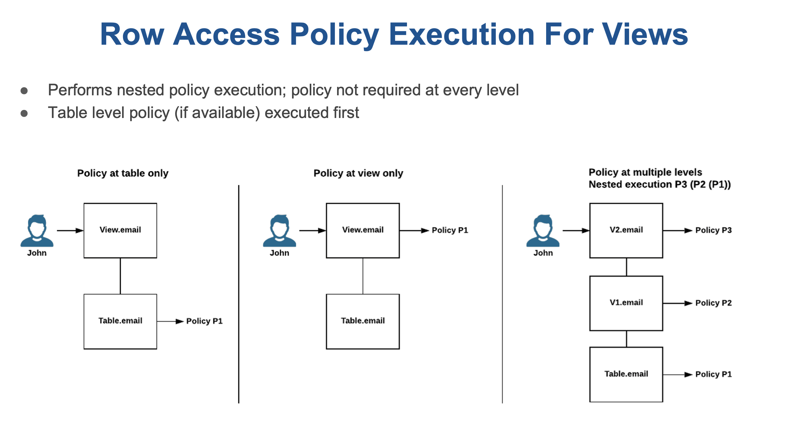
Downstream A ROW ACCESS POLICY

Slide 8
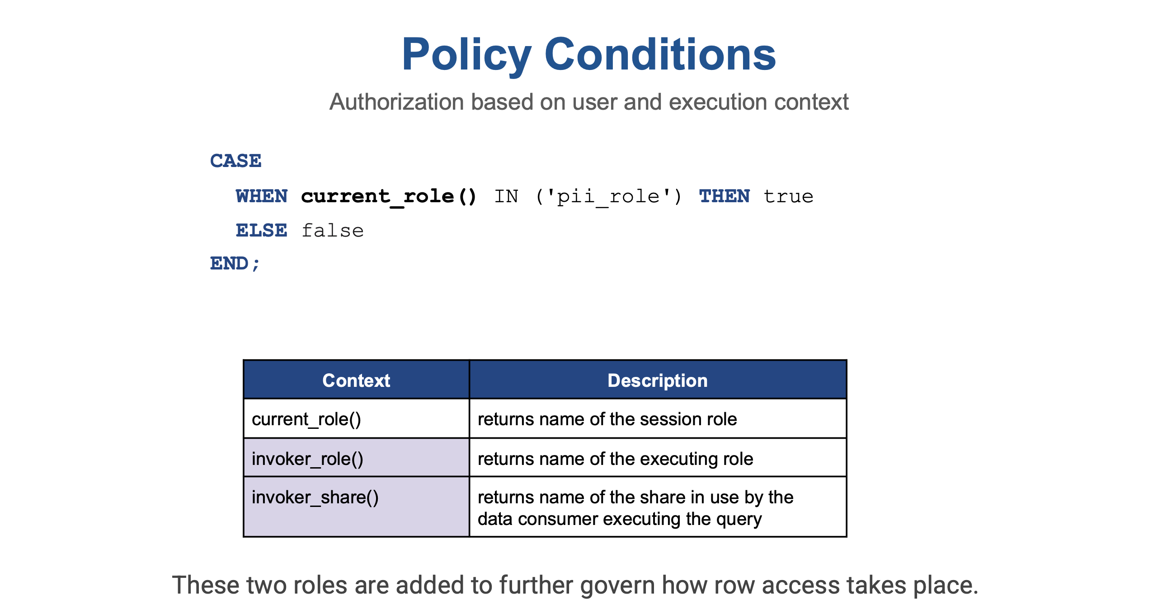

Slide 9
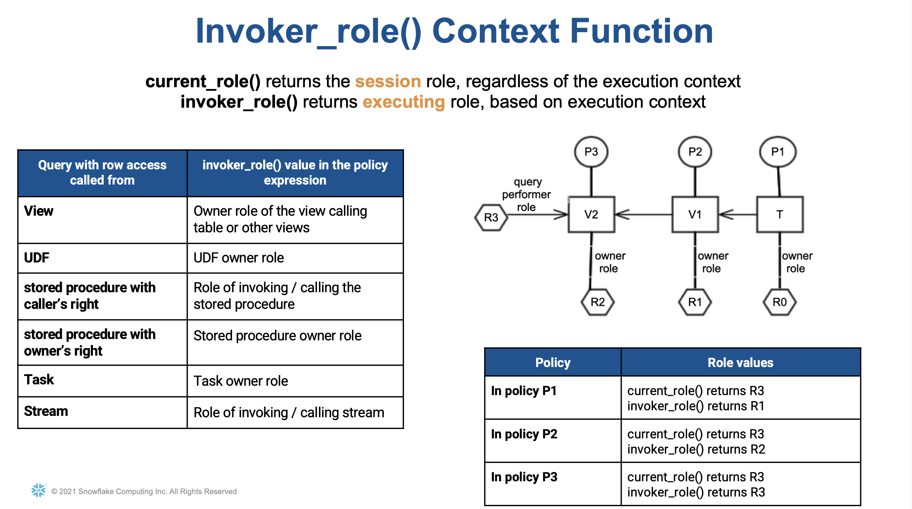
R0
R1
R2

Slide 10
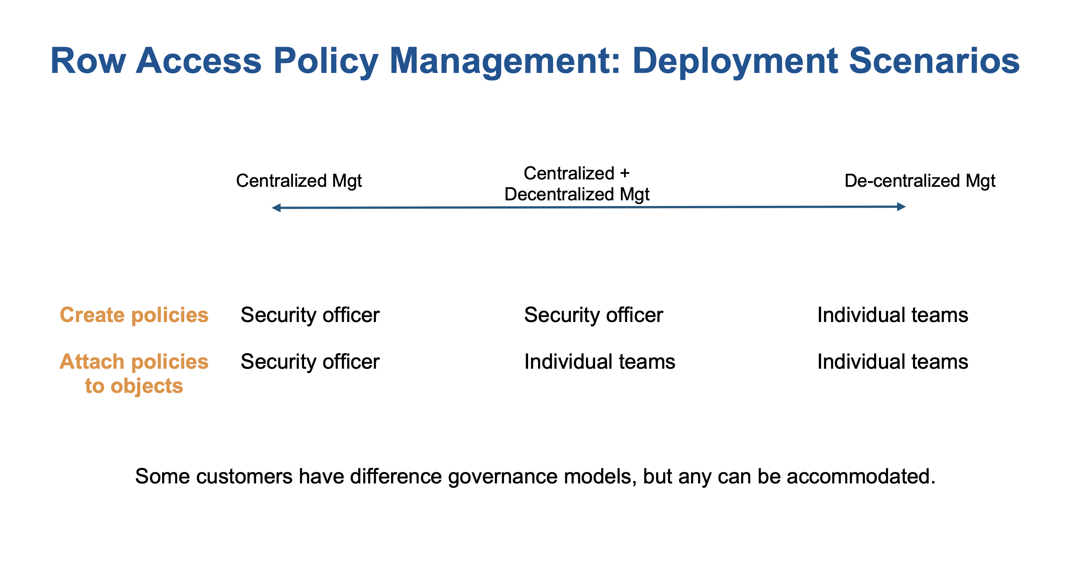

Slide 11
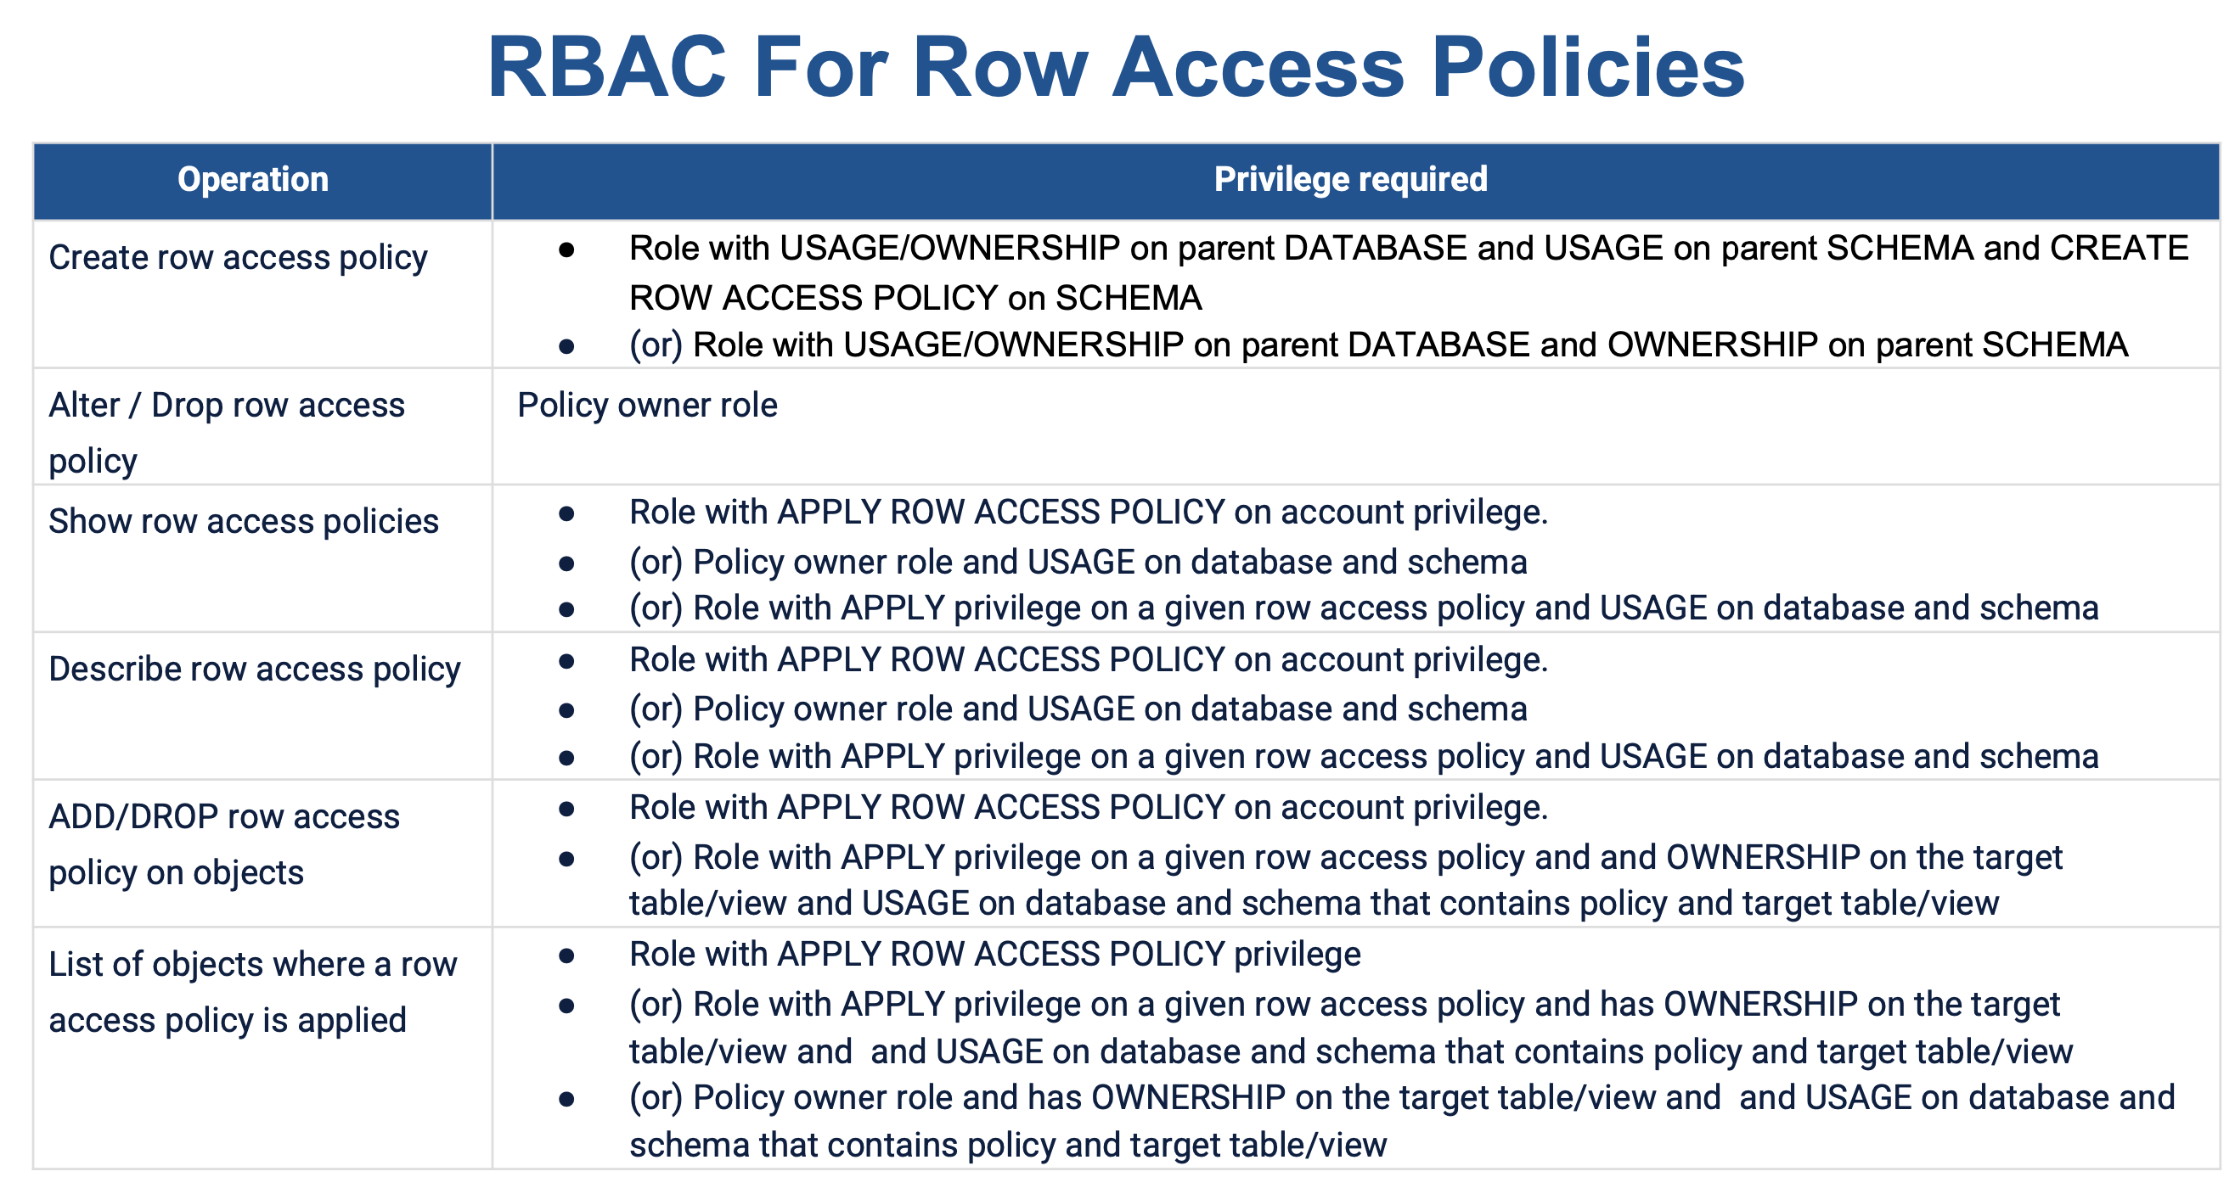

Slide 12
How?
For the time being we could deploy with the DDL these alter statements so that RLS and table creation go hand in hand, or we could create a table driven/procedure that will allow for policies to be maintained.
Option 1: DBT?
Option 2: Stored Proc

Slide 13

(Future) Tags
Object within Snowflake can be associated to a tag or labels so that they can be associated by a common quality
Benefit:
Allows for better visibility of used objects used downstream
Ease of Analysis
Easy Implementation
Allows for easier Masking and Row level policies application
Note: This is not in Pr or GA yet
For the time being we could deploy with the DDL these alter statements so that RLS and table creation go hand in hand, or we could create a table driven/procedure that will allow for policies to be maintained.

